Slide 1
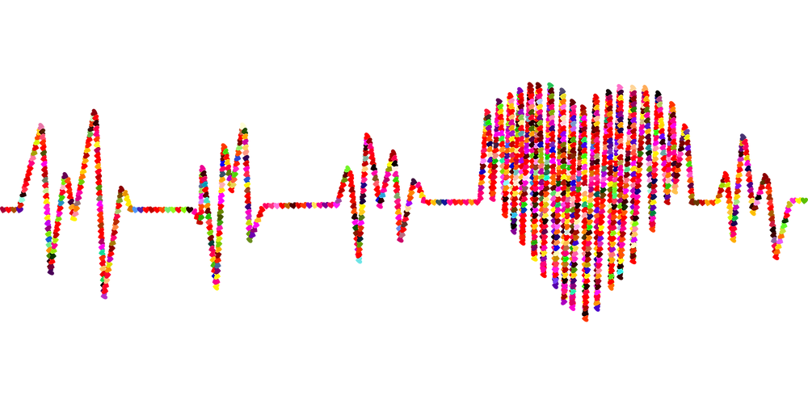
Data Analytics Bootcamp –UoT Final Project - Group 7
PREDICTION OF FACTORS LEAD TO HEART DISEASE

Slide 2
CONTENTS
Overview
Objective
What we used
Exploratory Data Analysis
Data Storage
Machine Learning Models
Dashboard
Conclusion
Our team

Slide 3
OVERVIEW :
According to the WHO, heart diseases are the leading cause of death globally. Approximately 17.9 million people die each year from heart diseases and estimated around 32% of all deaths worldwide. There have been identified many important factors which lead to heart disease. Identifying those risk factors and motivating people to adopt and following healthy behaviours is very important.

Slide 4
OBJECTIVE:
Our team use a heart disease dataset with different factors to predict which factors are at highest risk of leading to heart disease. Our team’s target audience would be the health care professionals as they will be able to apply the most current and up to date research and evidence to patient care and helping people preventing premature deaths related to heart diseases.

Slide 5
WHAT WE USED FOR THE ANALYSIS

Slide 6








Data Source and Resources Resources: Click here https://www.kaggle.com/datasets?search=heart+disease. Data Source: heart_disease_key_indicators.csv
Tools/Libraries
Technologies
Algorithms Logistic Regression Random Forest Classifier Xgboosting
Languages

Slide 7
EXPLORATORY DATA ANALYSIS

Slide 8

Questions To Be Answered..
What are the key indicators that lead to heart disease ?
What factors had the greatest influence on a person developing heart disease and in what proportions ?
Can a machine learning model accurately predict whether a person will develop heart disease based on the data provided ?

Slide 9
Understand the Data
Importing libraries and files for exploratory data analysis
Clean the Data
Analysis of relationship between variables
Creating data frame and checking number of columns and rows.
Checking the data types.
Checking the data characters mistakes.
Checking the null values.
Checking and removing the duplicates.
Transforming the target variable.
Loading data
Target variable visualization
Other variable against target variable visualizations.
Correlation Visualization.

Slide 10
Features
Independent Variables
Categorical
Smoking, AlcoholDrinking, Stroke, Sex, PhysicalActivity,
Asthma, KidneyDisease, SkinCancer, Diffwalking
Continuous
BMI, PhysicalHealth,
MentalHealth,
AgeCategory,
GeneralHealth,
Diabetic,
Sleeptime, Race
Dependent Variables
HeartDisease (Categorical)

Slide 11
Features Analysis
Categorical Variables ( Binary ) | Continuous Variables ( Non Binary )
HeartDisease Smoking AlcoholDrinking Stroke Diffwalking PhysicalActivity Asthma KidneyDisease SkinCancer Sex | BMI – Healthy Weight, Obesity, Over Weight, Under Weight PhysicalHealth – Index Number Race – Native, White, Black, Asian, Hispanic, Other MentalHealth – Index Number Age Category – In Years General Health – Excellent, Very good, Good , Fair , Poor Diabetic – Yes, No , Border line, During Pregnancy Sleeptime – In hours
Yes – 1
No – 0
Female – 1
Male – 0

Slide 12
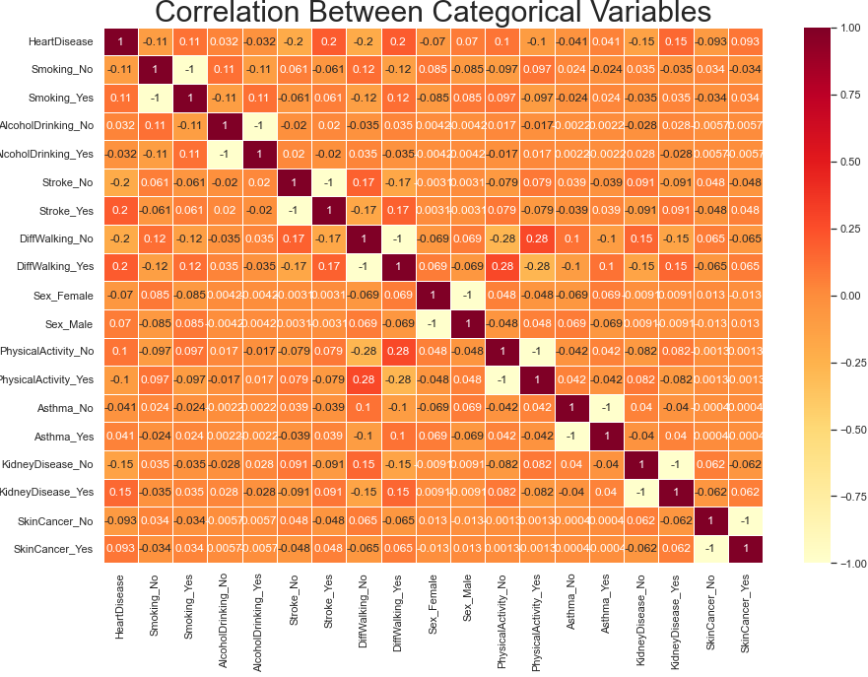
Being a person who has stroke , a person is smoking , a person with no physical activities , a person with kidney disease shows low positive correlation.
A person use alcohol shows very low negative correlation.
A person with skin cancer , a person with Asthma shows no correlation

Slide 13
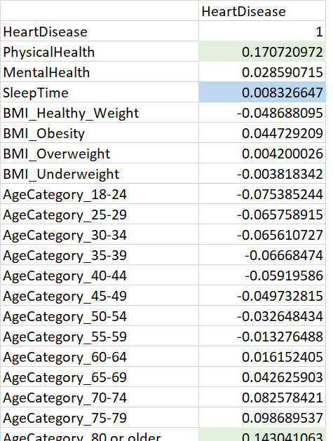
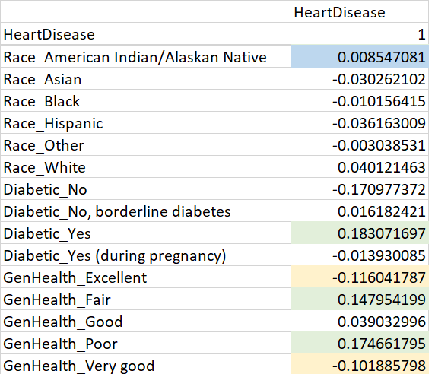
Correlation Between Continuous Variables
Physical health, Age category above 80 or older , a person with diabetic , a person with poor general health has lower positive correlation with the target variable.
A person with an excellent general health shows a lower negative correlation with the target variable.
Race has no correlation with the target variable

Slide 14
DATA STORAGE

Slide 15
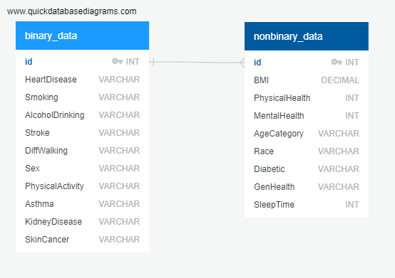

Using PgAdmin – PostgreSQL to store and join our data
Creating tables for binary and nonbinary data using SQL
Joining tables using id column as the primary key
Tables were joined using an inner joint.
The resulting table connected with the model using psycopg2 library

Slide 16
MACHINE LEARNING MODELS

Slide 17
Machine Learning Cycle
Data Preparation
Eliminated duplicate values
Model Selection
Logistic Regression
Model Evaluation
Based on:
Checked null values
Create bines for BMI column
Random Forest Classifier
XGBoost
Precision
Recall
Accuracy
F1
Model Tuning
Used different optimization techniques to optimize each model’s performance
Results
Definitions and Calculations of Scores
Accuracy: the difference between its predicted values and actual values.
Precision: Precision = TP/(TP + FP) Precision is a measure of how reliable a positive classification is.
Sensitivity = TP/(TP + FN) Sensitivity is a measure of the probability of a positive test, conditioned on truly having the condition.
F1 = 2(Precision * Sensitivity)/(Precision + Sensitivity) A pronounced imbalance between sensitivity and precision will yield a low F1 score.

Slide 18
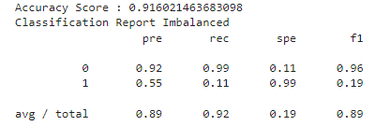
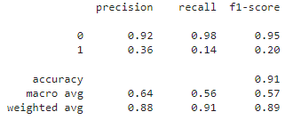
Results Before Optimization
Model | Accuracy Score | Precision Score | Recall Score | F1 Score
Logistic Regression | 91% | 89% | 92% | 89%
XGBoost | 75.8% | 76% | 76% | 76%
Random Forest Classifier | 90% | 88% | 91% | 89%
*All models were working for just one output

Slide 19
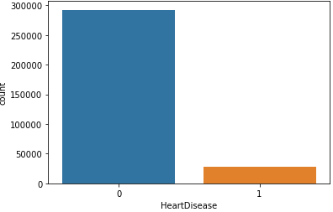
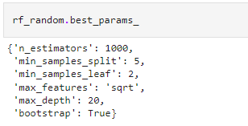
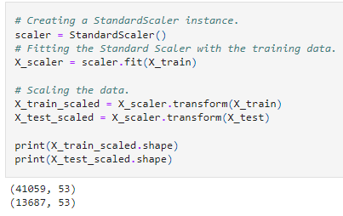
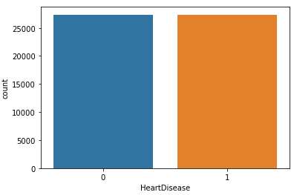
We implemented three optimization techniques to improve each model’s performance
Sampling
We were dealing with an unbalanced dataset so we used under sampling method to optimize our models .
Scaling
We used Standard Scaling to make data points generalized so that the distance between them were lower.
HO
Tuned the hyperparameters of the Random Forest model to optimize its performance.

Slide 20
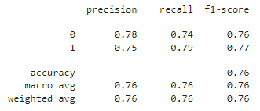
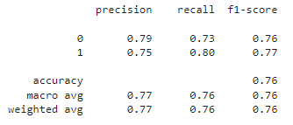
Results After Optimization
Model | Accuracy Score | Precision Score | Recall Score | F1 Score
Logistic Regression | 76.4% | 76% | 76% | 76%
XGBoost | 75.8% | 76% | 76% | 76%
Random Forest Classifier | 76.5% | 77% | 76% | 76%
*All models were working for both output
Random Forest Classifier is the best model for our data

Slide 21
DASHBOARD

Slide 22

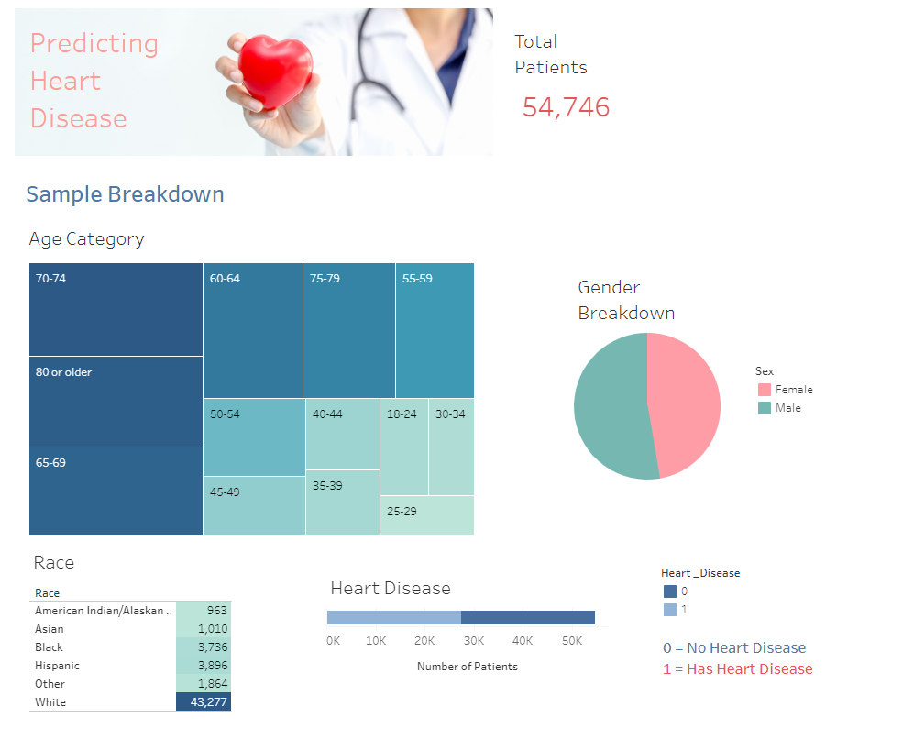
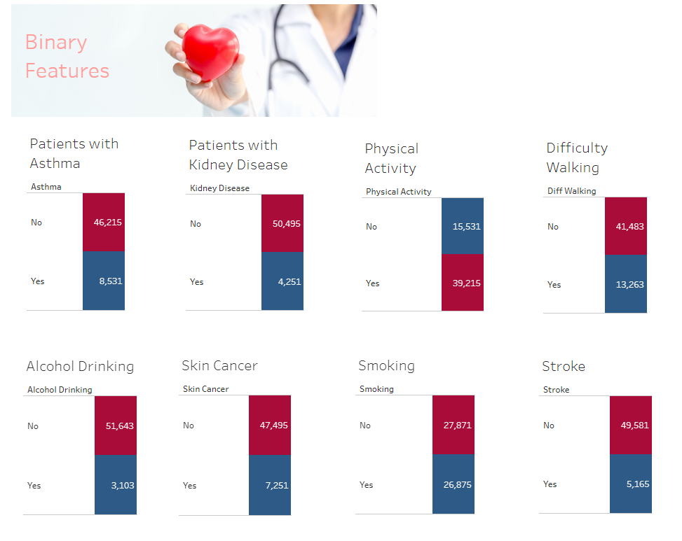
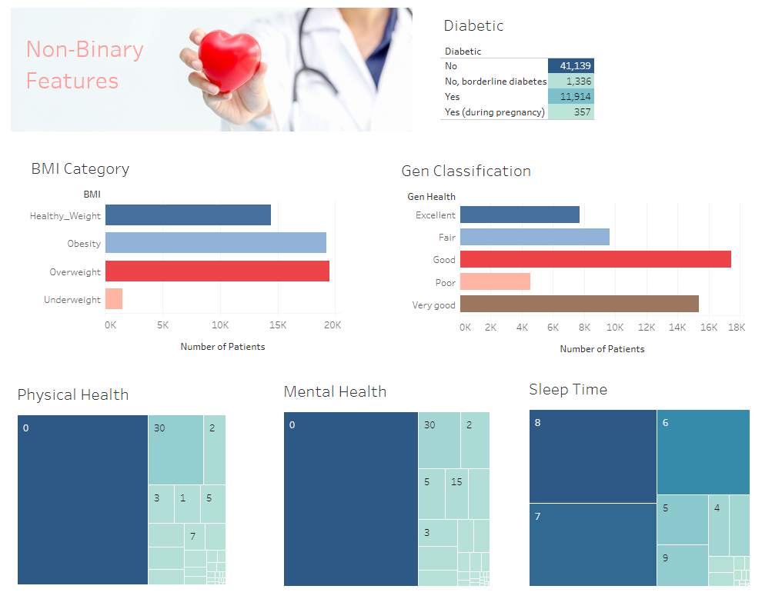
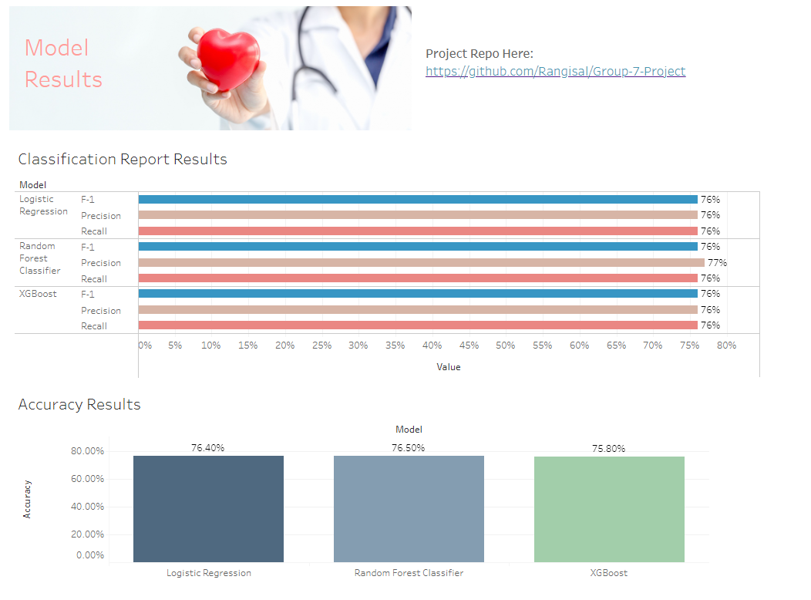
Using Tableau to present an overview of the data
The tables and graphs reflect information from our dataset and allow the users to get a good overview of the factors leading to predict heart disease.
It illustrates the connection between the binary and non binary features to the target variable.
All models’ results are displayed with graphs to visualize the comparison between them.
Please click here to view the interactive dashboard embed using tableau public.

Slide 23
CONCLUSION

Slide 24
All the models are equally tuned to correctly predict heart disease risk potential
However Random forest model slightly edged out the other models.
As per the feature important analysis sleep time, Physical health, Mental health and BMI obesity are shown as the key indicators for the prediction.
Age category between 18-24, 25-29, 30-34 , Race-Asian , Diabetic during pregnancy features are shown as the least factors for the prediction heart disease.

Slide 25




The Team
Ethan McBride
Andres Pombo
Sergei Zhukov
Marian Salgadoe
Q & A

Slide 26
THANK YOU !

